Slide 1
Privacy Protection for Preventing
Mobile Data Over-Collection
Wenyun Dai

Slide 2
Outlines
Introduction
Related Work
Background Study
System Models
Mobile-Cloud Framework Design
Experiments & Results

Slide 3
Contributions
Present mobile-cloud framework
Solve data over-collection problem
Improve security and privacy
Save storage space of smartphones
Main Methods:
Put all data into Cloud servers
Fine-grained permission authorization

Slide 4
Contributions
Quantify security risk
Design a benchmark
Score mobile apps
Score mobile devices
Usage:
To evaluate different approaches
Offer a standard measurement method

Slide 5
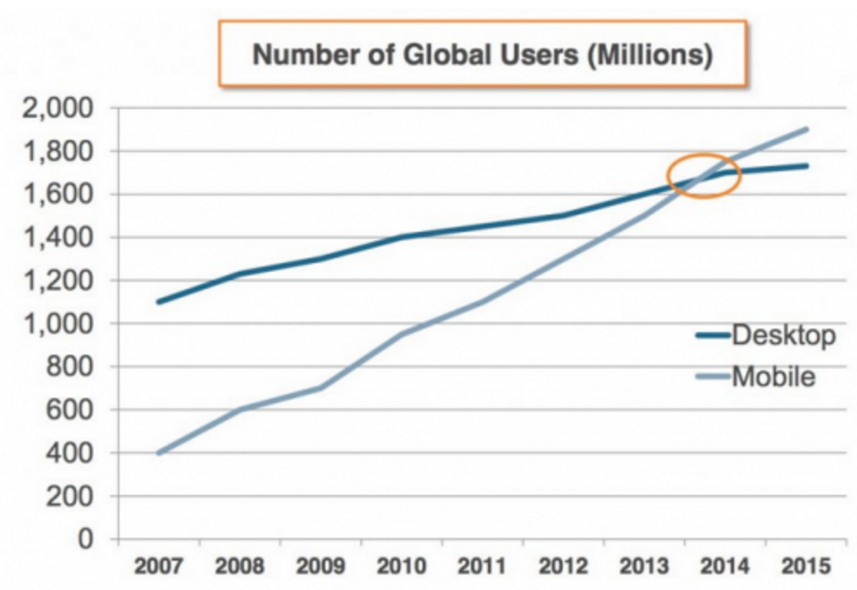
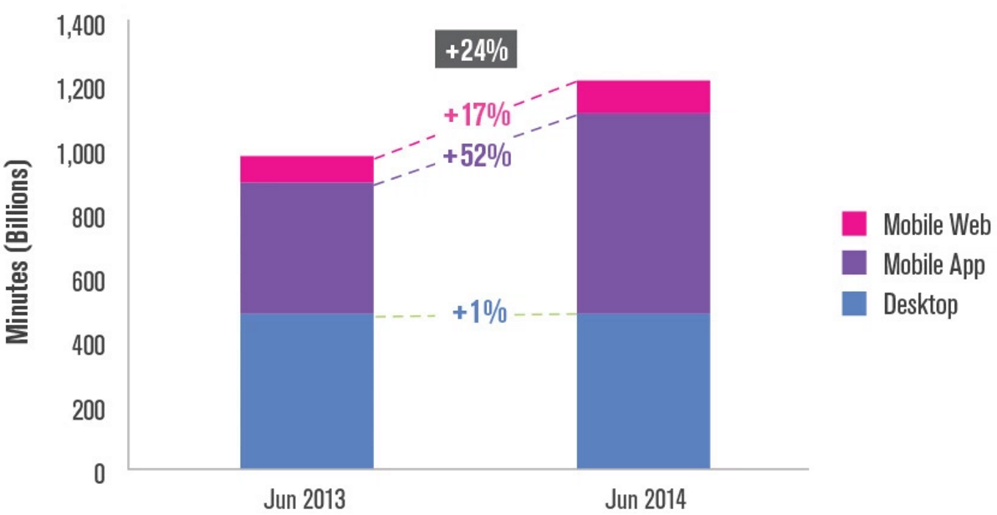

Role of Mobile Devices
Most widely used
# Mobile > # Desktop $↑$ Mobile > $↑$ Desktop
Report from Morgan Stanley Research and comScore

Slide 6
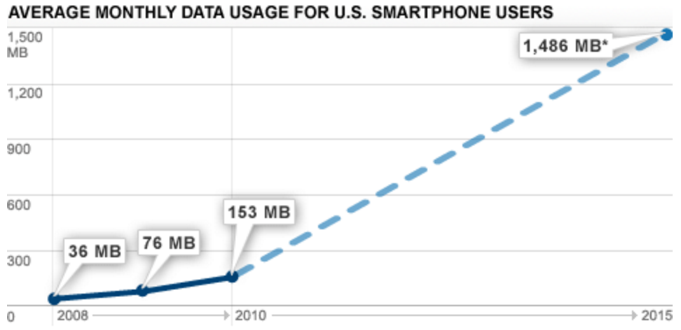
Store Data into Mobile Devices
Inevitable and Widespread
Report from CISCO: About 1500 MB Data Usage Monthly

Slide 7




Security Issues on Mobile
Malware (Virus): malicious software or app
iOS > Non-iOS
Development environment
Scrutiny of App Store
Solution: Antivirus Apps
Avast, ESET, Avira, 360, …
Mobile malware infects only 0.4% of mobile apps, 0% was found in the Top 400 ranking
Malware is a problem, but not the most important issue

Slide 8

Data Over-Collection
Mobile apps collect data more than enough on its original function required while within permission scope
Behaviors:
Location Information
Photos
Address Book
Calendar
International Mobile Equipment Identity (IMEI)
Unique Device Identifier (UDID)

Slide 9
Tracking Location
50% of top iOS free apps and 24% of top iOS paid apps are tracking users’ location (Appthority)
82% of top Android free apps and 49% of top Android paid apps are tracking users’ location (Appthority)
iOS > Android ?
No!
Frequent Location Service in iOS

Slide 10
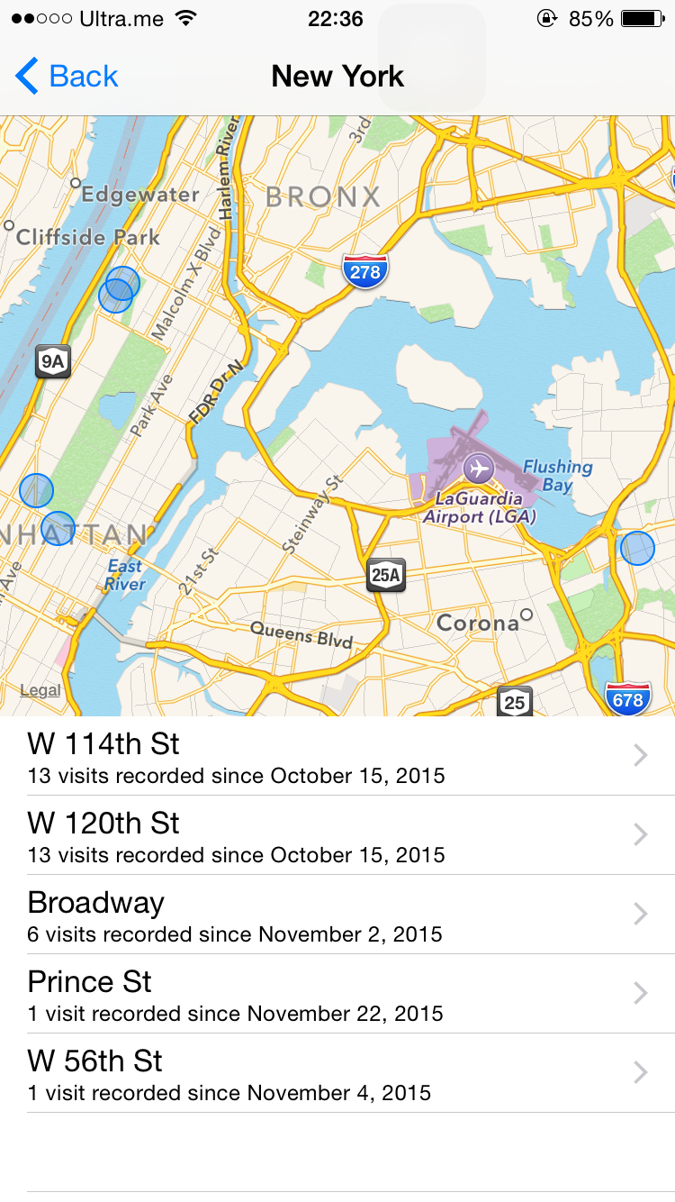
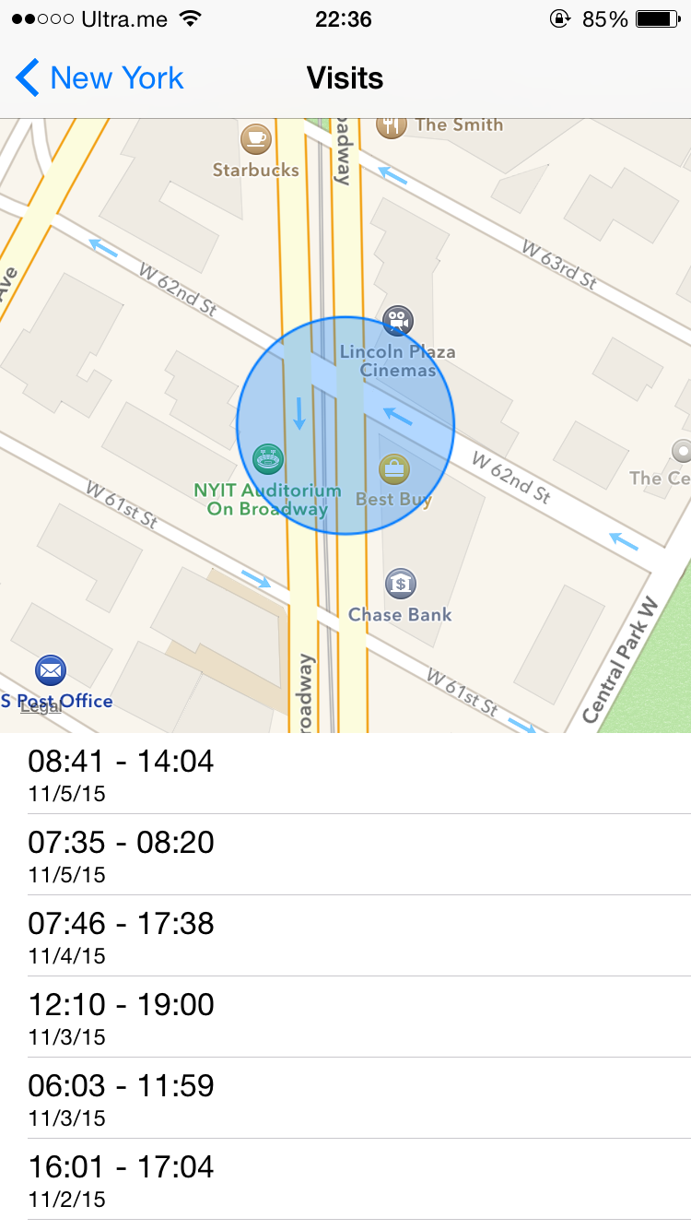
Tracking Location

Slide 11
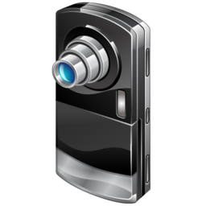
Accessing Photos
Posting photos via SNS apps, such as Facebook
But we just several photos, not all
Why?
Current OS: Coarse-grained permission authority
YES or NO
ALL or NONE
Worse
One-time operation
Until manually disable the permission in iOS
Until uninstall the app in Android

Slide 12

Accessing Address Book
26% of top iOS free apps and 8% of top iOS paid apps access users’ address books
30% of top Android free apps and 14% of top Android paid apps access users’ address books
Current OS: Coarse-grained permission authority
Contacts carry more valuable information
Sync with other email software, Apple Mail, Outlook, …
Enterprise information

Slide 13

Accessing Calendar
8% of the top iOS free apps and 1% of the top iOS paid apps access users calendars
2% of the top Android free apps and 4% of the top Android paid apps access users calendars
Usage:
Organize schedule
Track events
Reminder
Other information within the remark section
Risk: Corporate espionage

Slide 14
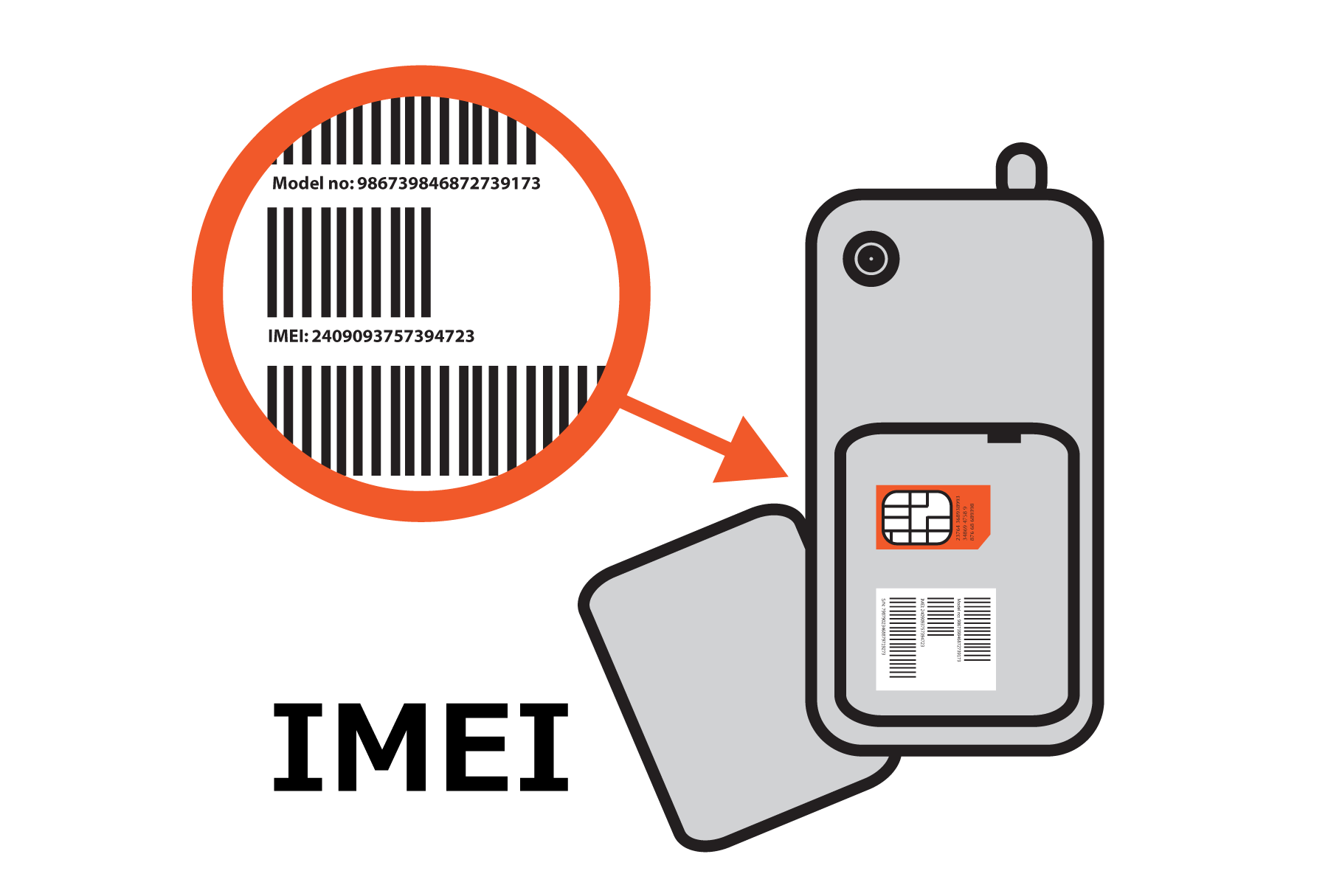
Tracking IMEI/UDID
Unique ID
57% of the top iOS free apps and 28% of the top iOS paid apps access IMEI/UDID
88% of the top Android free apps and 65% of the top Android paid apps access IMEI/UDID
Identify data referring to device, similar to the Primary Key in Database
Make other data much more valuable

Slide 15
Discussion: Risk
Data Over-Collection: Security and Privacy Hazard
Not only happed separately
But also work together
ID
Loc
Loc
Photo
Photo
IMEI/UDID
Contacts
Contacts
Calendar
Calendar

Slide 16
Discussion: OS
93% iOS apps exhibited at least one behavior
89% Android apps exhibited at least one behavior
Why?
Coarse-grained Permission Authorization
One-time permission authorization
No difference on different data

Slide 17
Related Work
PiOS --- detect privacy leaks in iOS
Static Analysis
Reconstruct the control flow to find code path from sensitive sources to sinks
A standard reachability analysis to find the path which connects nodes (sensitive info. --- network)
Data flow to verify whether sensitive info. is flowing from source to sink
M. Egele, C. Kruegel, E. Kirda, and G. Vigna, “PiOS: Detecting privacy leaks in iOS applications,” in Proceedings of the 18th Annual Network & Distributed System Security Symposium (NDSS), 2011

Slide 18
Related Work
TaintDroid --- dynamic taint tracking in Android
Real-time Analysis
Leverage Android’s virtualized execution environment
Instrument the VM interpreter for variable-level tracking
Message-level tracking between applications
File-level tracking to ensure persistent info. retains taint
W. Enck, P. Gilbert, B.-G. Chun, L. P. Cox, J. Jung, P. McDaniel, and A. N. Sheth, “Taintdroid: An information-flow tracking system for realtime privacy monitoring on smartphones,” in USENIX 9th Conference on Operating Systems Design and Implementation, 2010, pp. 1–6

Slide 19
Related Work
Automated Validation
Commodity Cloud infrastructure to emulate smartphones
Dynamically track information flows and actions
Build Dependency graphs based on information flows and actions
Detect misuse of sensitive data via Dependency graphs
P. Gilbert, B.-G. Chun, L. P. Cox, and J. Jung, “Vision: Automated security validation of mobile apps at app markets,” in ACM 2nd International Workshop on Mobile Cloud Computing and Services, 2011, pp. 21–26

Slide 20
Related Work
Kirin --- Evaluate apps before installing
Extract security manifest of Android
Evaluate manifest against logic invariants
Privacy control approach
Static info. Flow → classify to safe or unsafe
A tamper analysis to track whether private data is obscured before escaping
X. Xiao, N. Tillmann, M. Fahndrich, J. De Halleux, and M. Moskal, “User-aware privacy control via extended static-information-flow analy- sis,” in IEEE/ACM 27th International Conference on Automated Software Engineering, 2012, pp. 80–89

Slide 21
System Model
No Industrial Standard for security and privacy
To quantify all attributes, including
Data type
Data amount
Over-Collection Behavior
Leakage method

Slide 22

Security and Consumption Model
Security Levels based on privacy
IMEI/UDID --- Highest
Address book > Photo > Calendar …
Security level → requirement → computational resource
Security level (SL) $↑$, encryption $↑$, execution time (T) $↑$, energy consumption (EC) $↑$
$SL= α∗T, EC= β∗T,$
$SL= \frac{α}{β}∗EC$
To tradeoff security and energy consumption

Slide 23
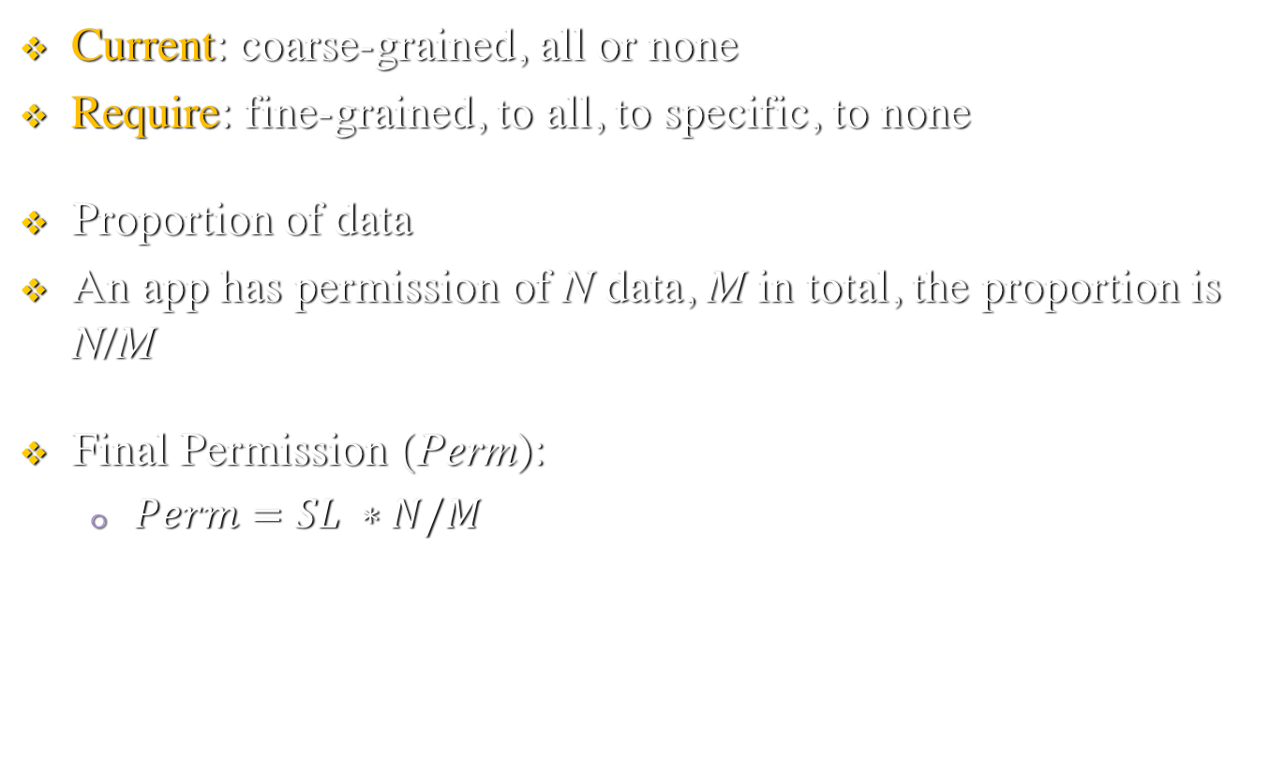
Permission Model
Current: coarse-grained, all or none
Require: fine-grained, to all, to specific, to none
Proportion of data
An app has permission of N data, M in total, the proportion is N/M
Final Permission (Perm):
$Perm=SL ∗N/M$

Slide 24
Security Risk Model
Security Risk represents the potential harm to the security and privacy when some risk happens
Severer than malwares
How?
Lurk at the victim mobile devices and keep collection sensitive and private data
Once collecting enough data, the harm is destructive

Slide 25

Security Risk Model
Security Risk (SR)Product of security violation probability and the damage
${SR}_{i}^{d}= {SL}^{d}∗{Pro}_{i}^{d}$, i: app, d: data
${Pro}_{i}^{d}=1 − e^{−λ∗N_{i}^{d}/M_{i}}$ , $λ$ is the security risk coefficient of the behavior of the app i over-collecting data d
${SR}_{i}^{d}$ = ${SL}^{d}$ * ($1 − e^{−λ∗N_{i}^{d}/M_{i}}$)
Security risk of app i towards an user (U):
${SR}_{i}^{U}$ = $\sum_{d=0}^{M}{{SL}^{d}}$*($1 − e^{−λ∗N_{i}^{d}/M_{i}}$)
A mobile device with A amount of apps
${SR}_{A}^{U}$ = $\sum_{i=0}^{A}{\sum_{d=0}^{M}{{SL}^{d}}\text{∗(}1 − e^{−λ∗N_{i}^{d}/M_{i}}\text{)}}$

Slide 26
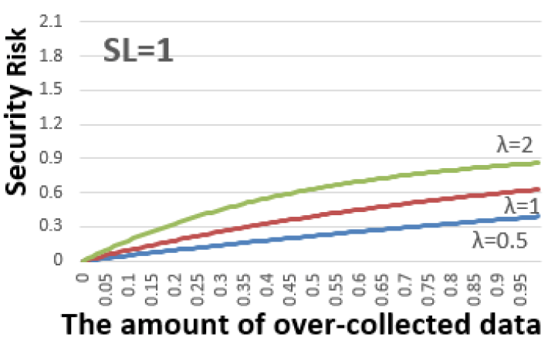
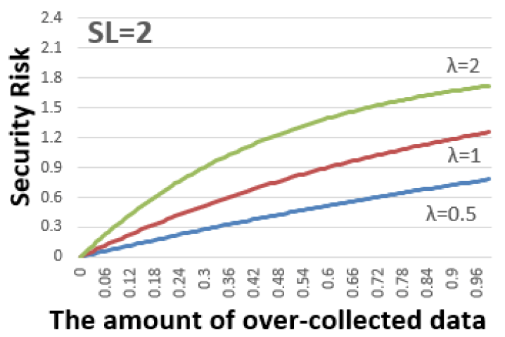
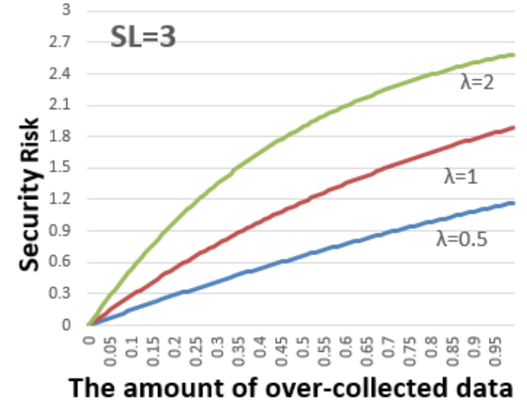
Security Risk & Data Amount

Slide 27

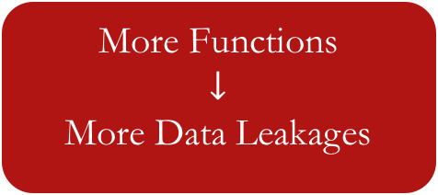
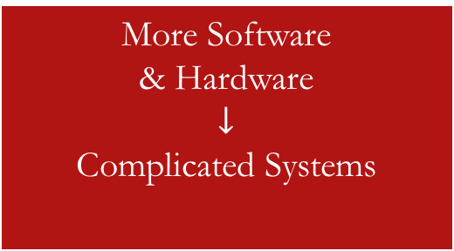
Way Out
The significant problems we face cannot be solved at the same level of thinking we were at when we created them.
More Software
& Hardware
$$↓$$
Complicated Systems
More Functions
$$↓$$
More Data Leakages
Communication
Tools
App developers don’t collect data or don’t sell them to ad. networks and third party organizations.
All mobile devices users can understand permission clearly and protect their privacy carefully.

Slide 28
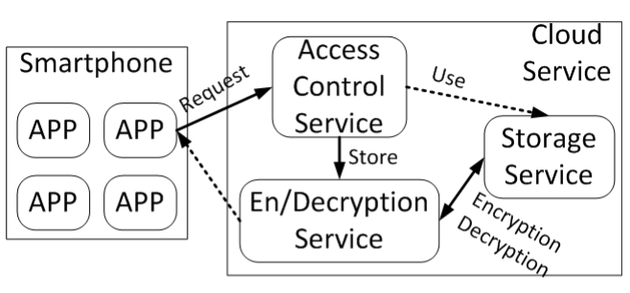
Mobile-Cloud Framework
Putting data into cloud
Users are free of managing
Use Cloud service to manage data and security
Let professional ones do
Use Cloud service for encryption and decryption

Slide 29
Case 1
An user use a SNS app to access the camera for taking an instant photo
Get request type T
Send T to Access Control Service with appID, userID, and data
Get result P from ACS
Encryption Service encrypts data
Store data into Storage with label appID

Slide 30
Case 1
2
3
1
4
5

Slide 31
Case 2
An user want to share some photo via some SNS app
Get request type T
Send T to Access Control Service with appID, userID, and Pdata
Get permission P from ACS
Storage Service get encrypted data Edata
Send Edata to Decryption Service to be decrypted, data
Decryption Service double check the permission
Return

Slide 32
Case 2
2
3
1
4
5
7
6

Slide 33
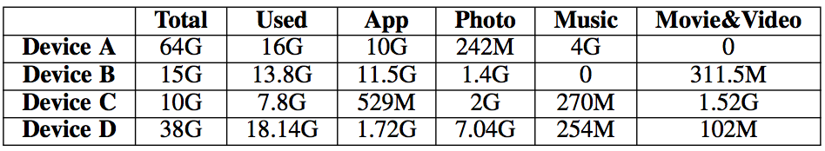
Experiments --- Setup
Four real smartphones
One Cloud server
Data Usage of experimental smartphones
Security level of data

Slide 34
Experiments --- Score Apps
Four degrees of score:
Do not collect data --- 100
Do not transmit data --- 70
Transmit data to app developers --- 40
Transmit data to third parties --- 10
Result:
Original: less than 60, even 34
Ours: greater that 64

Slide 35
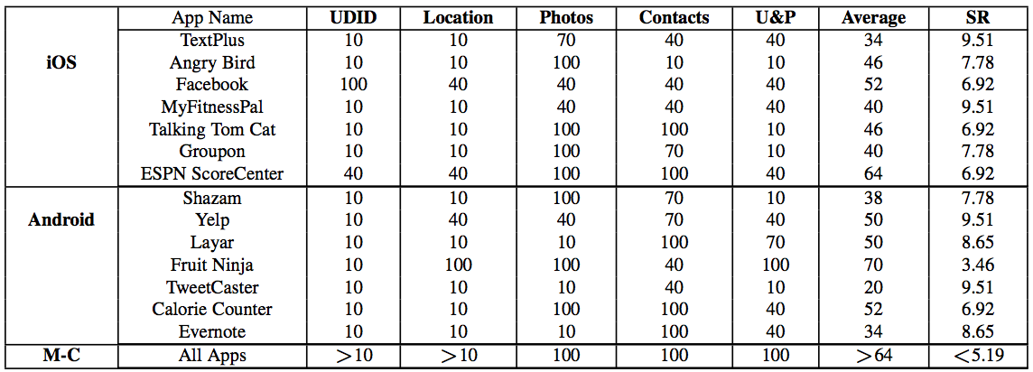
Experiments --- Score Apps

Slide 36
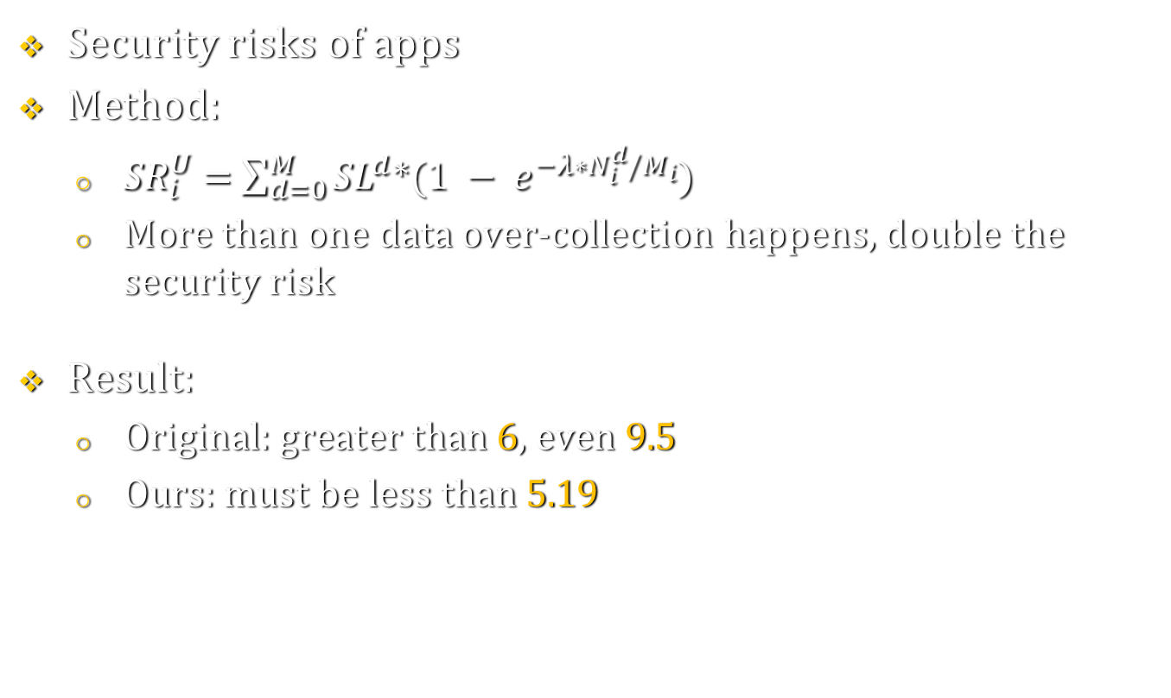
Experiments --- Score Apps
Security risks of apps
Method:
${SR}_{i}^{U}$ = $\sum_{d=0}^{M}{{SL}^{d}}$*($1 − e^{−λ∗N_{i}^{d}/M_{i}}$)
More than one data over-collection happens, double the security risk
Result:
Original: greater than 6, even 9.5
Ours: must be less than 5.19

Slide 37
Experiments --- Score Apps

Slide 38
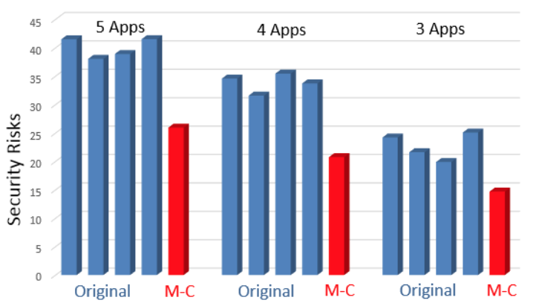
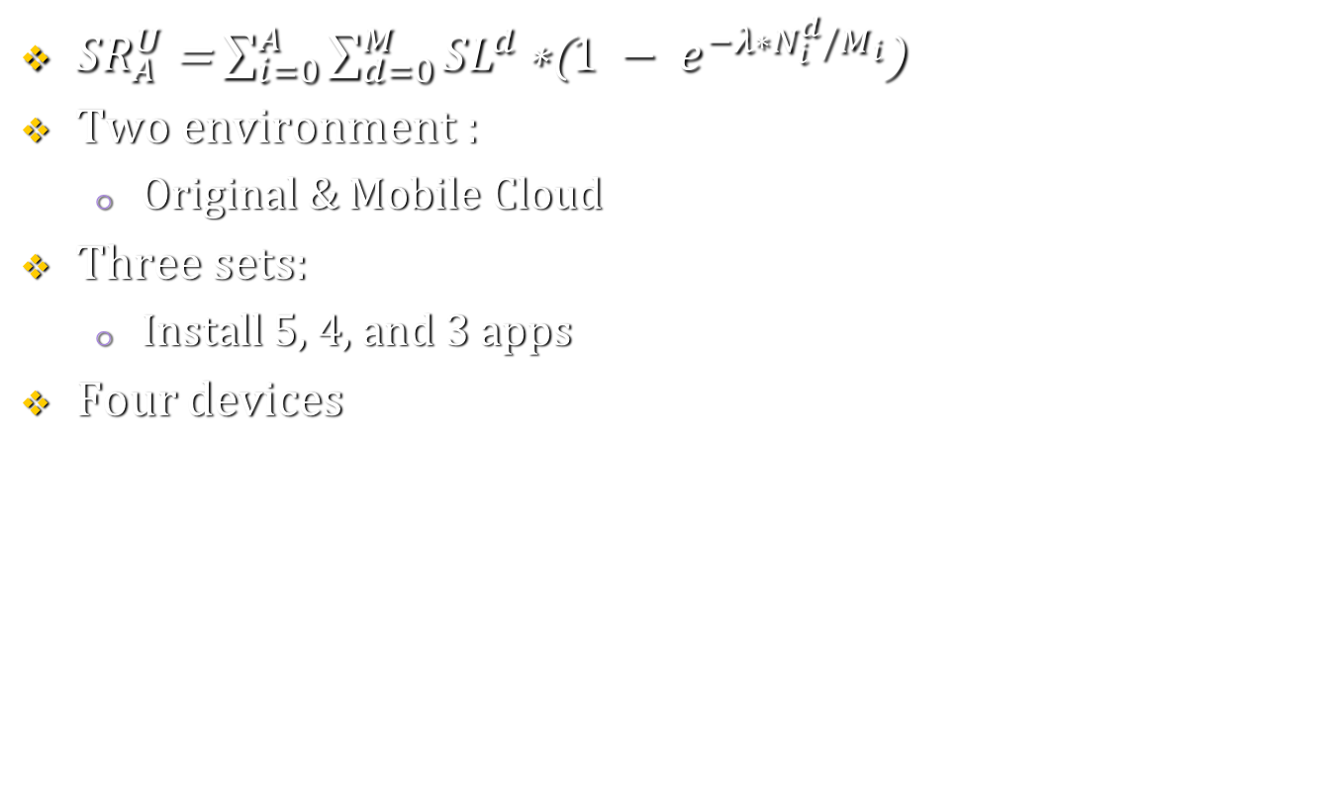
Experiments --- Security Risk of Devices
${SR}_{A}^{U}$ = $\sum_{i=0}^{A}{\sum_{d=0}^{M}{{SL}^{d}}\text{∗(}1 − e^{−λ∗N_{i}^{d}/M_{i}}\text{)}}$
Two environment :
Original & Mobile Cloud
Three sets:
Install 5, 4, and 3 apps
Four devices

Slide 39
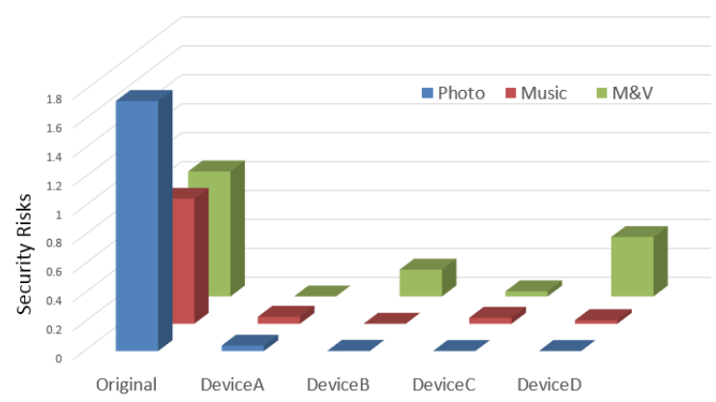
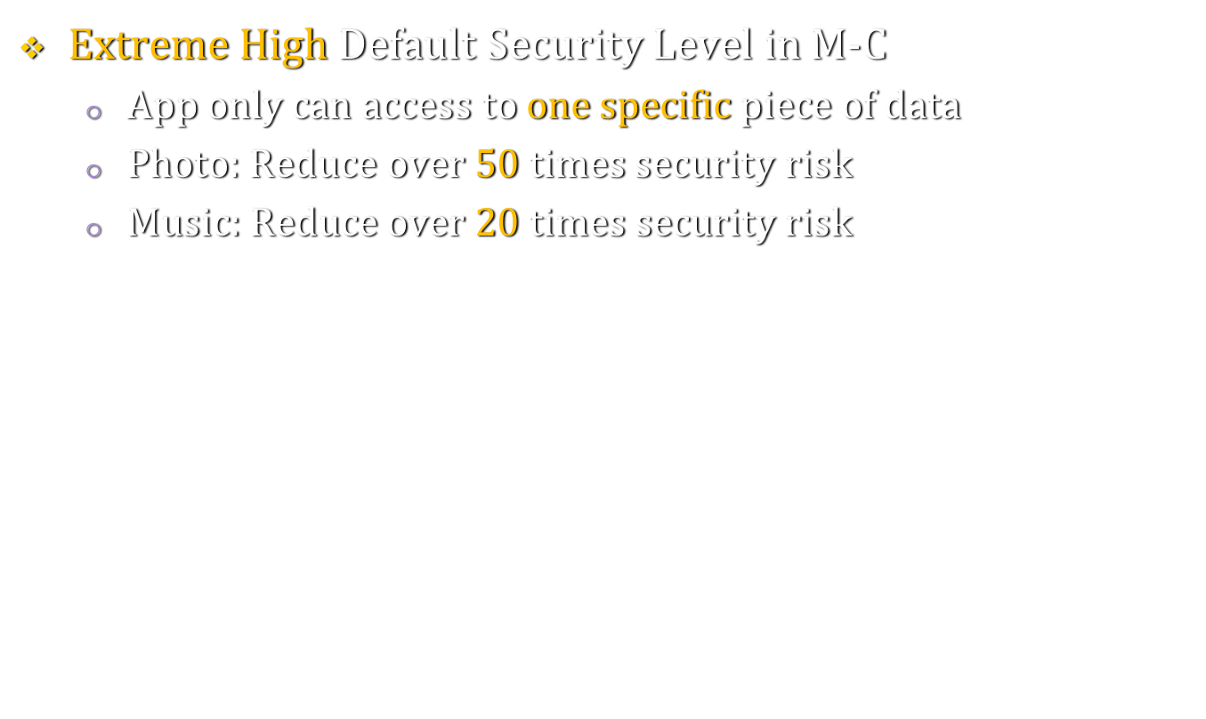
Experiments --- Different Security Level
$Extreme$ High Default Security Level in M-C
App only can access to one specific piece of data
Photo: Reduce over 50 times security risk
Music: Reduce over 20 times security risk

Slide 40
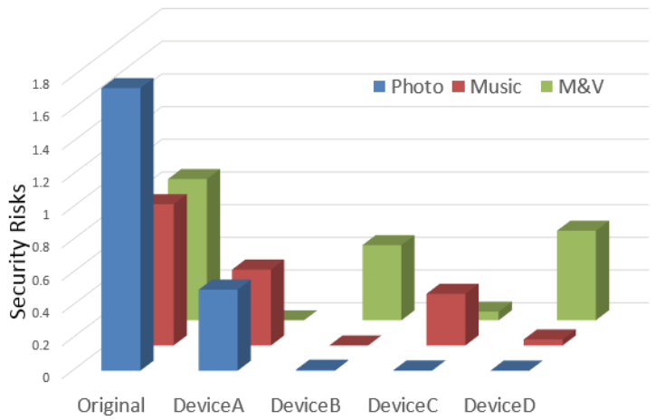
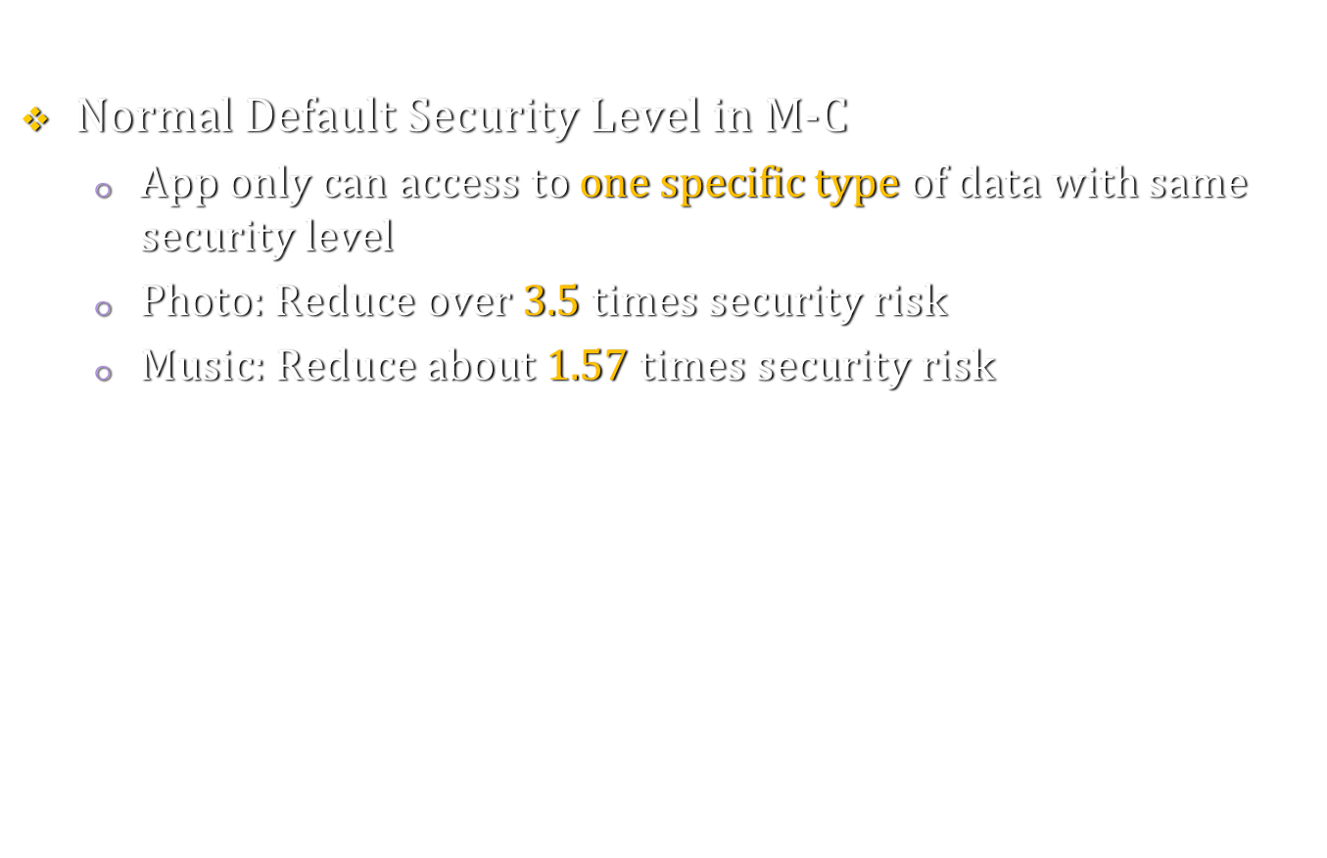
Experiments --- Different Security Level
$Normal$Default Security Level in M-C
App only can access to one specific type of data with same security level
Photo: Reduce over 3.5 times security risk
Music: Reduce about 1.57 times security risk

Slide 41
THANK YOU

